Slide 1
Understanding HLS Design based on the Vitis Tutorial-2
AIHA-Intern-2023-NPU
Dongbeom Son / Wonbin Seo / Sumin Lee
bumin35@hanyang.ac.kr / kkyou123@hanyang.ac.kr / slbiog3025@hanyang.ac.kr
2023 aiha-intern

Slide 2
Table of Contents
Basic Data Flow in AES
Connectivity
  Kernel to Kernel
  Kernel to Global Memory
  krnl_cbc
  Host to Kernel
  Host to Global Memory
Testbench
XRT API Call
Device Map
Kernel Replacement
  Remove ports not used
  Modify engine
  Simulation
  Change Kerenl_cbc_engine
  P&R, schematic
  host_sw code modification, verification

Slide 3
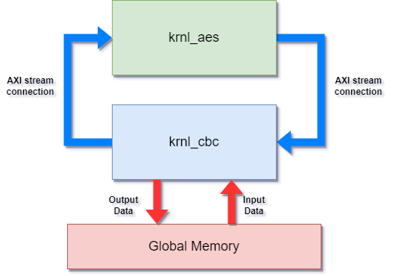
Basic Data Flow in AES
  Read → krnl_cbc → cbc_engine → input_buffer →
  axis (master to slave)→ krnl_aes → axis → krnl_cbc
  → cbc_engine (0~3) (output_buffer) → write

Slide 4
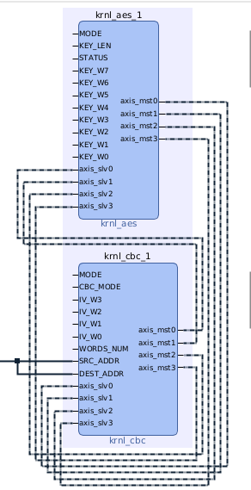
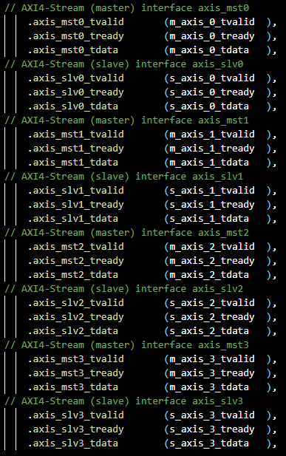
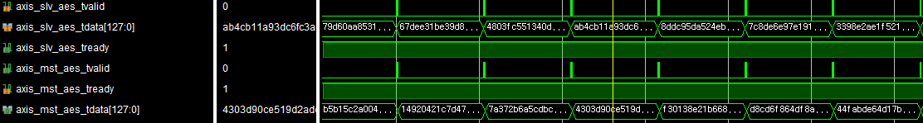
Connectivity
Kernel to Kernel
  AXIS interface
    Uni-directional transfer between kernel
    No address
    Unbounded Data set
    Does not use Global Memory
  Krnl_cbc to krnl_aes
    4 AXIS Master and Slave interface on each kernel
    Transfer Cipher data

Slide 5

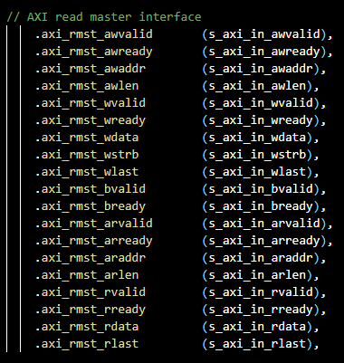
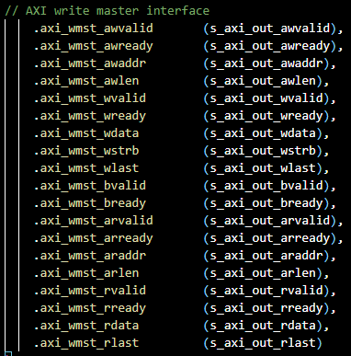
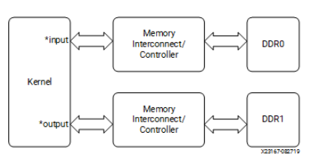
Connectivity
Kernel to Global Memory
  Memory mapped interface
  AXI Master port in kernel
  AXI Slave port in Global memory
  Buffer base offsets are given by host
Notes:
In buffer – read master, out buffer – write maste

Slide 6
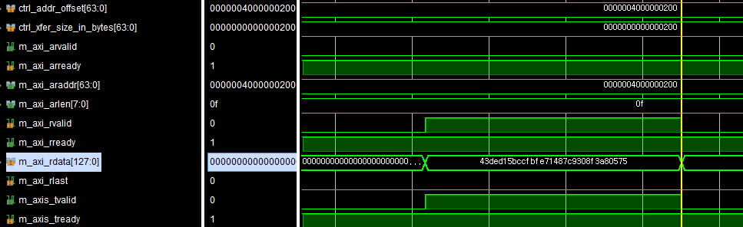
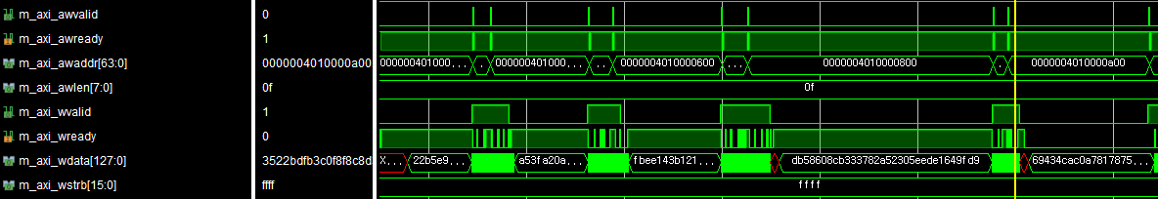
Connectivity
krnl_cbc
  Using 2 AXI4 Master Interface to read/write data in Global Memory
  Only a single CU can transfer data to/from global memory bank at one time
  limiting the overall performance of the application
    Unable to read/write data simultaneously if both buffers are in same bank
    Can customize the global memory bank connections by modifying the memory interface connection
    Can use Burst based access
Notes:
In buffer – read master, out buffer – write maste

Slide 7
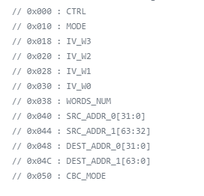
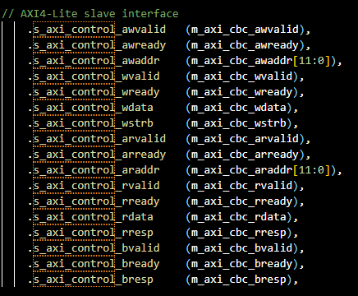
Connectivity
Host to Kernel
  AXI4 Lite-slave interface
    Setting kernel arguments in control register
    Transfer Kernel execution signal (ap_start, ap_done, ap_ready, ap_continue)
    Transfer buffer base address of global memory
  Krnl_cbc
    Execution mode, CDC_mode
    Initialization vector
    Source, destination address and word number

Slide 8
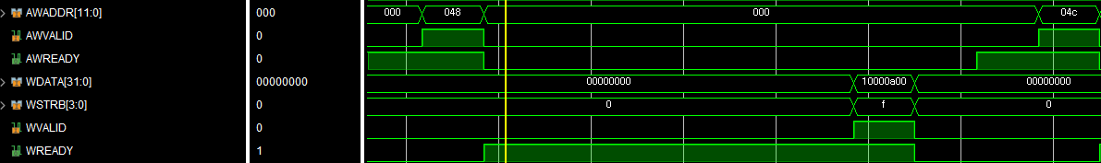
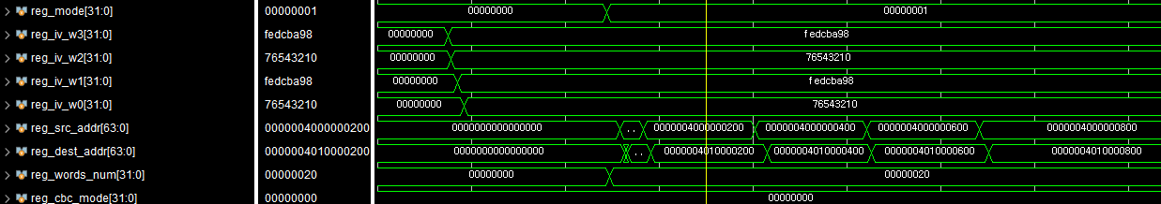
Connectivity
Host to Kernel
  AXI4 Lite-slave interface
    Setting kernel arguments in control register
    Transfer Kernel execution signal (ap_start, ap_done, ap_ready, ap_continue)
    Transfer buffer base address of global memory
  Krnl_cbc
    Execution mode, CDC_mode
    Initialization vector
    Source, destination address and word number

Slide 9
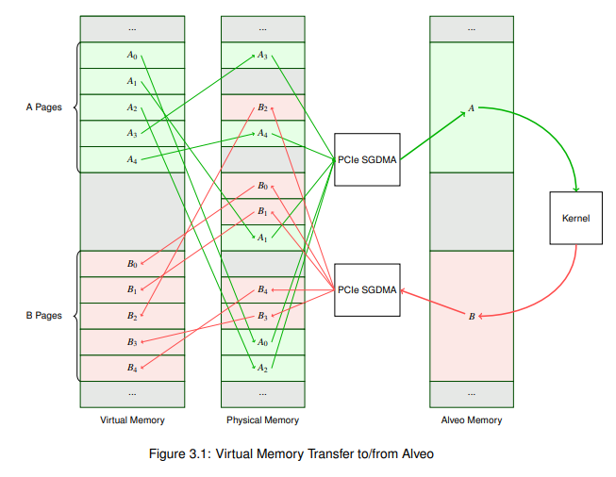
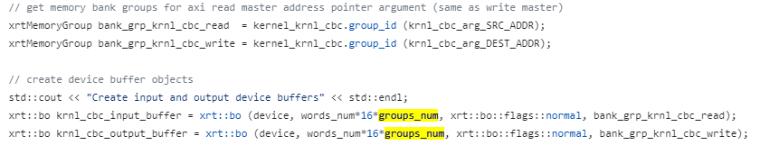
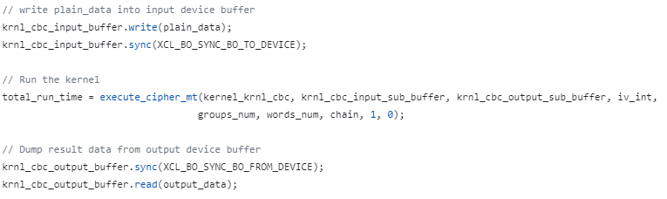
Connectivity
Host to Global Memory
  Normal buffer allocation creates buffer on both host side and device side(global memory)
  Base addresses of Buffers are sent to host
  Buffer in global memory are contiguous
  Data transfer between host buffer and device buffer
  Is synchronizing two buffers utilizing PCI express

Slide 10
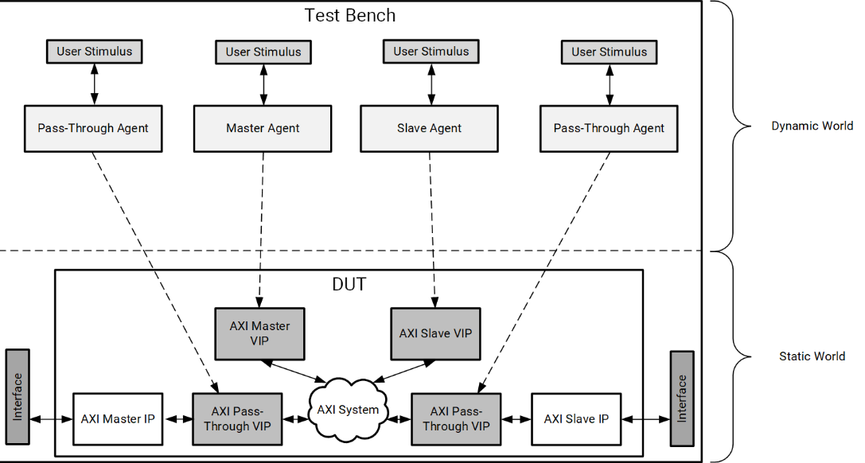
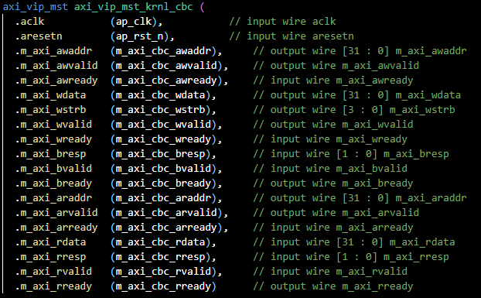
Testbench
AXI Master/Slave VIP
  Cannot access Global Memory in testbench
  Instead, using AXI Master/Slave VIP

Slide 11
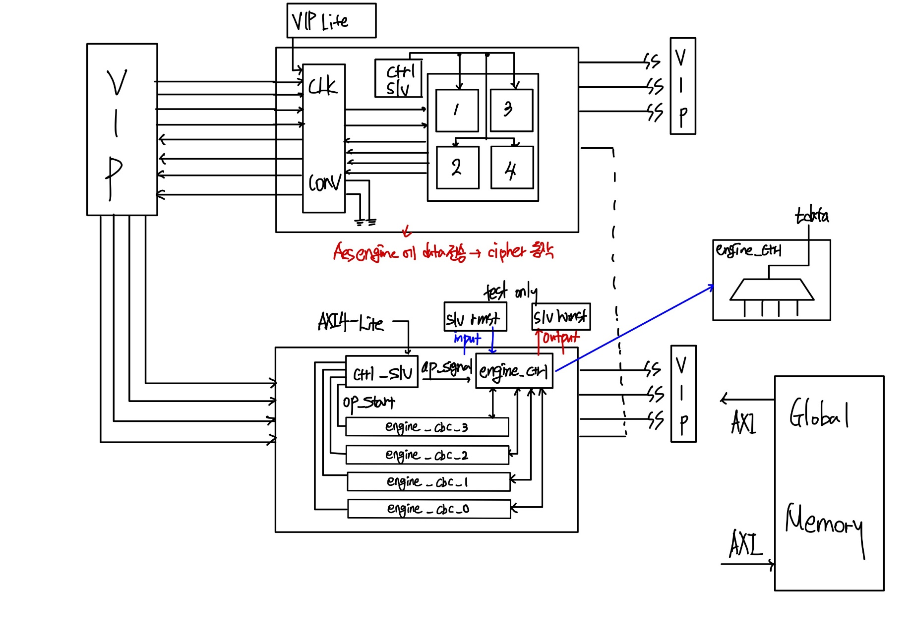
Testbench Diagram

Slide 12
XRT API Call
XRT Native API
  xrt::run - Execution of the kernel
  xrt::run::wait - block current thread until current execution is finished
  Data transfer between Host and device by Buffer read/write API
    xrt::bo::sync with flag XCL_BO_SYNC_BO_TO_DEVICE : write operation
    xrt::bo::sync with flag XCL_BO_SYNC_BO_FROM_DEVICE : read operation
    After sync, xrt::bo::write/read (operation) API is called

Slide 13
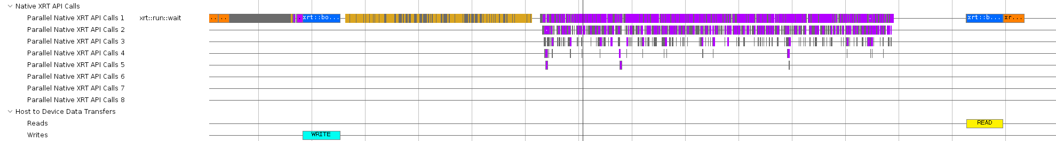
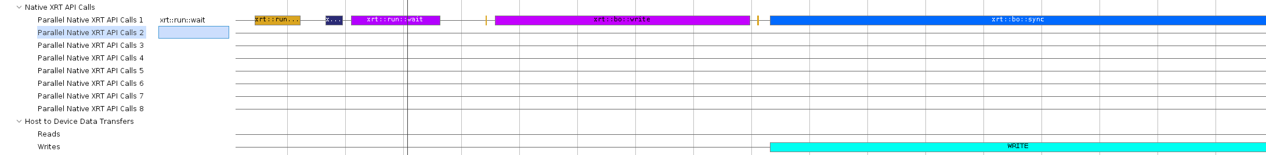
XRT API Call
Write to Read Operation
  Overall
  Write (with xrt::run, xrt::run::wait, xrt::bo::sync)

Slide 14
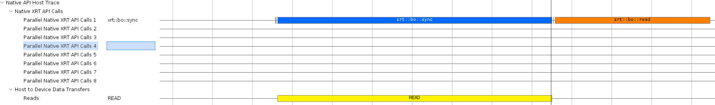
XRT API Call
Write to Read Operation
  Read

Slide 15
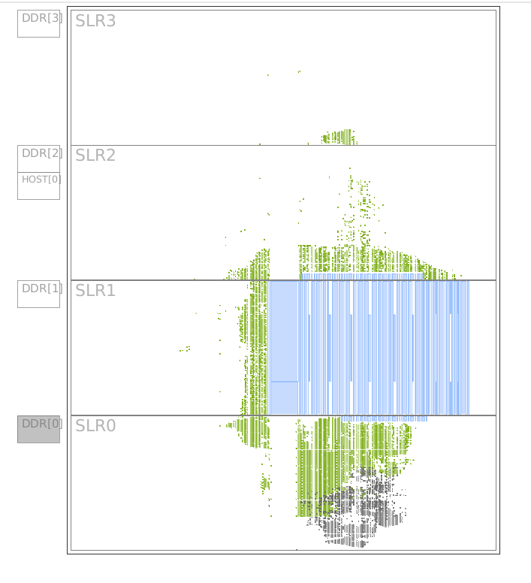
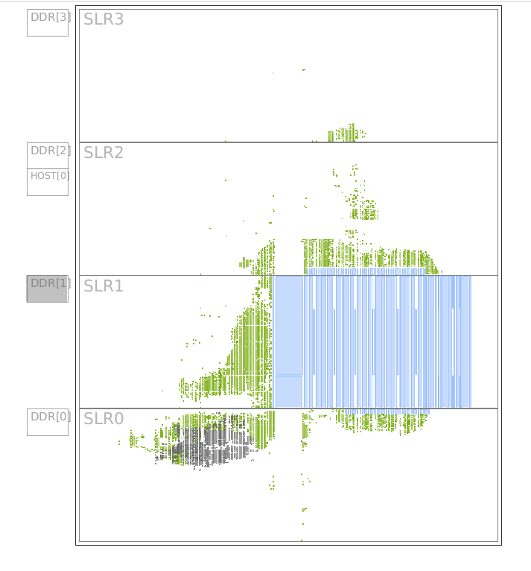
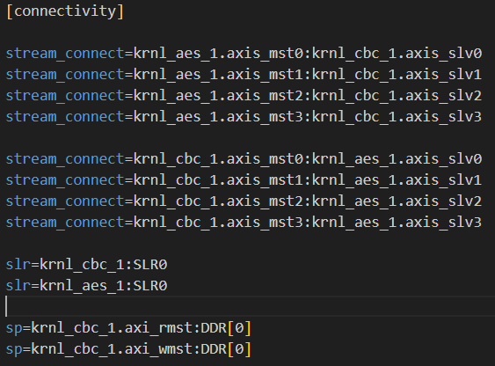
Device Map
SLR configuration
  SLR and memory bank that Kernel will operate can be modified in krnl_cbc_test.cfg
    Krnl:SLR0, DDR[0]
    Krnl:SLR0, DDR[1]

Slide 16
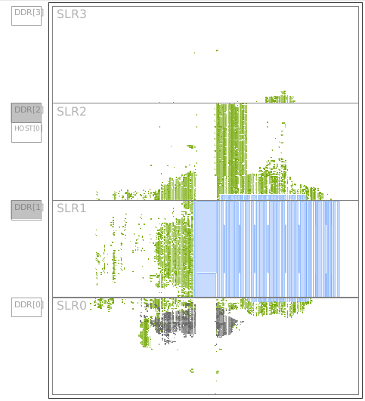
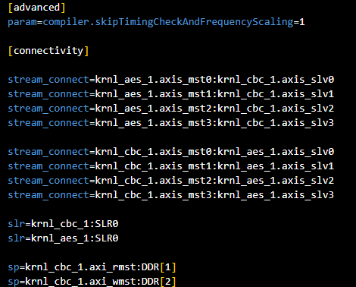
Device Map
SLR configuration
  Using several banks is possible
    rmst : DDR[1] wmst : DDR[2]

Slide 17
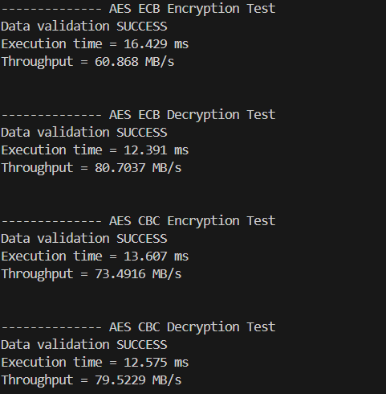
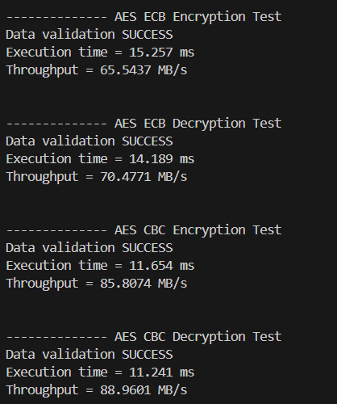
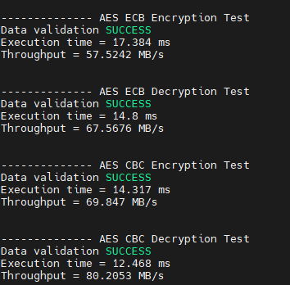
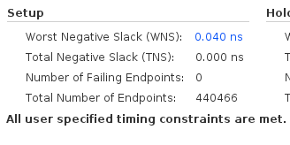
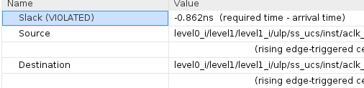
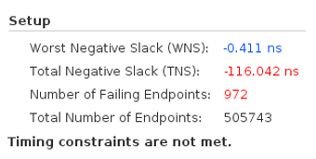
Device Map
SLR configuration
  Using several banks is possible
  Arbitrarily changing routing can lower slack

Slide 18
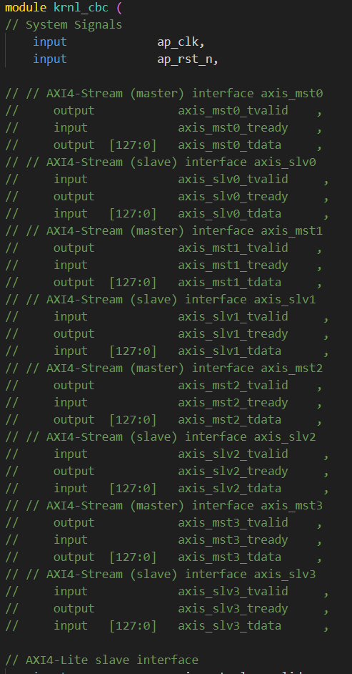
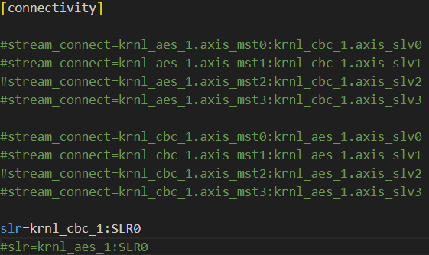
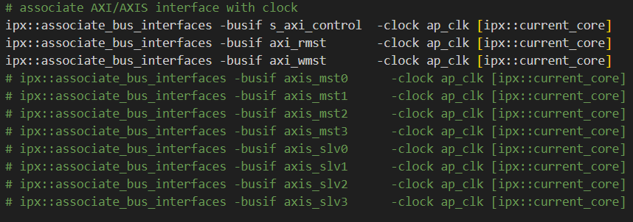
Kernel replacement
Remove ports not used
    krnl_cbc_test.cfg
    pack_krnl.tcl

Slide 19
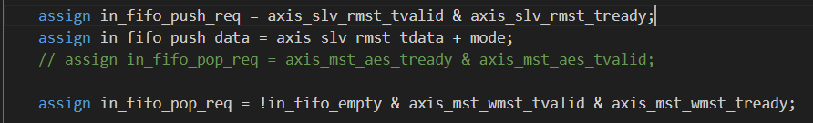
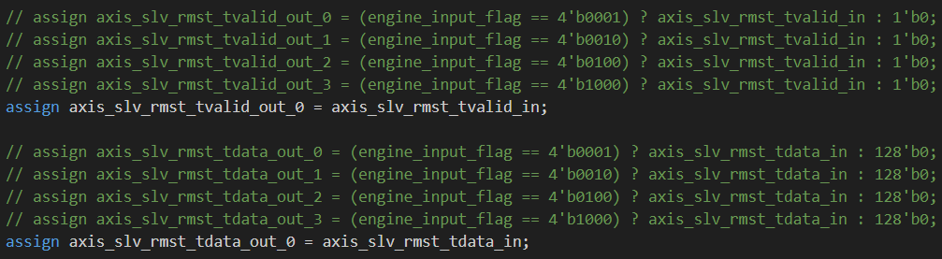
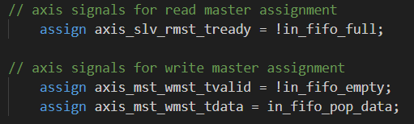
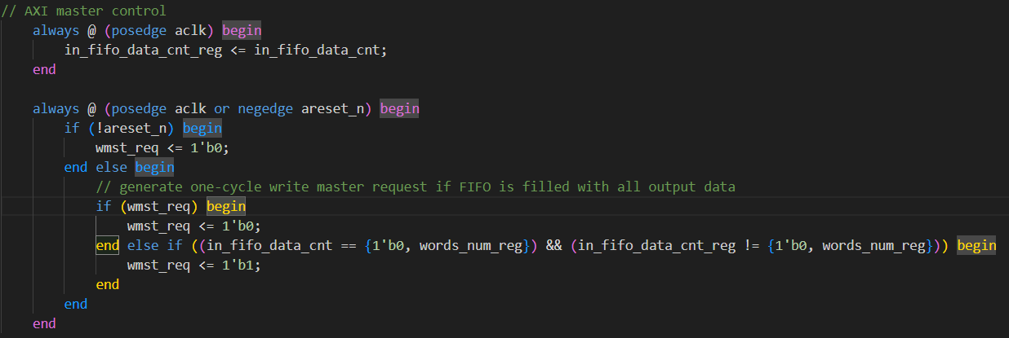
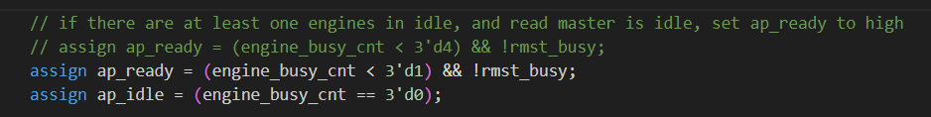
Kernel replacement
Modify engine
    engine_control.v
    add_engine.tcl

Slide 20
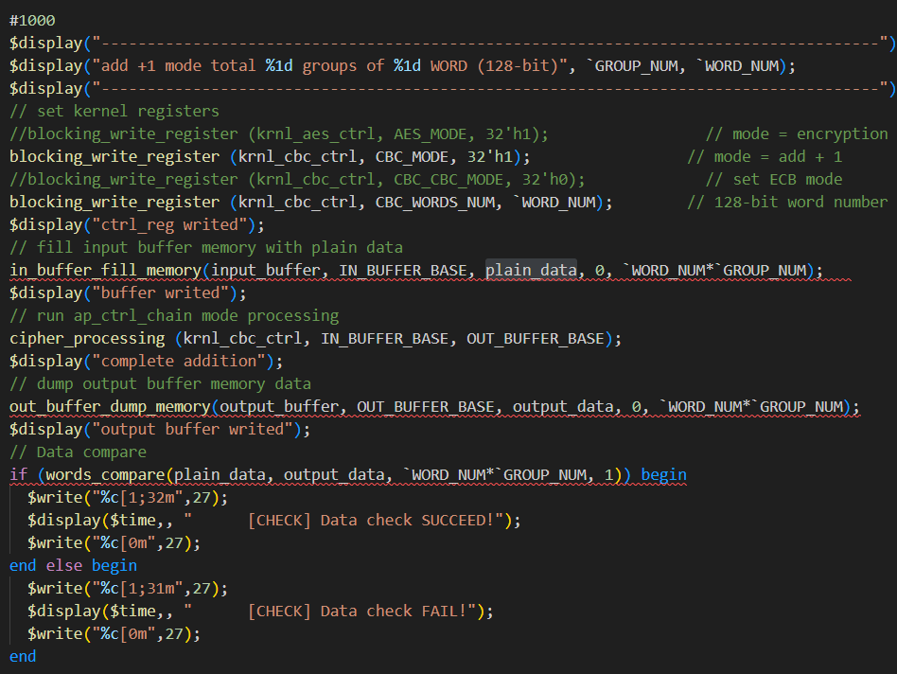
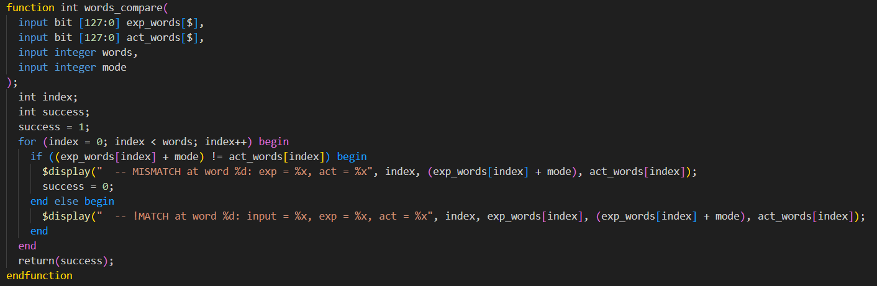
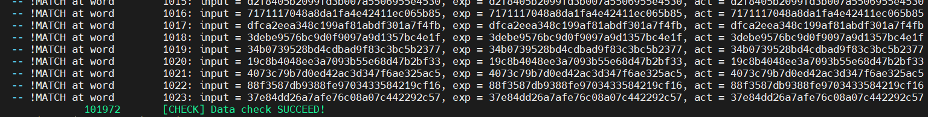
Kernel replacement
Simulation
    tb_krnl_cbc.sv
    tb_krnl_cbc.vh

Slide 21
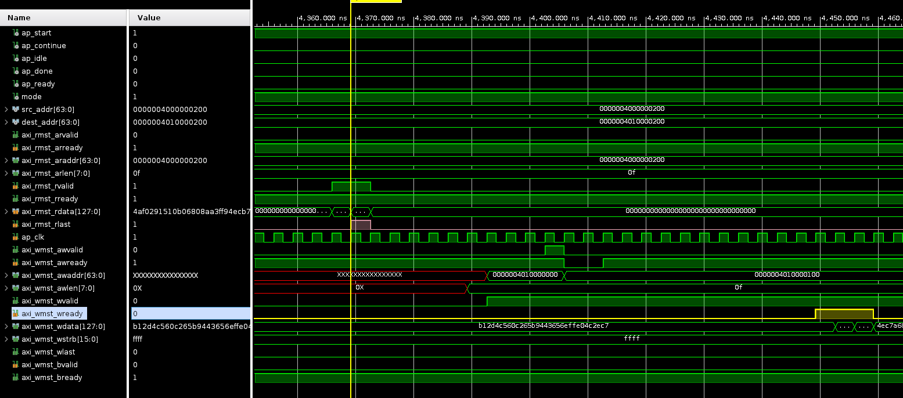
Kernel replacement
Simulation

Slide 22
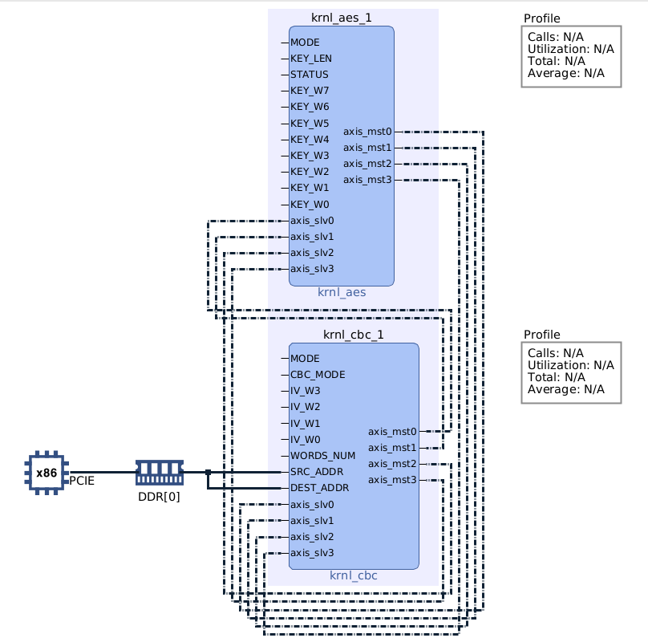
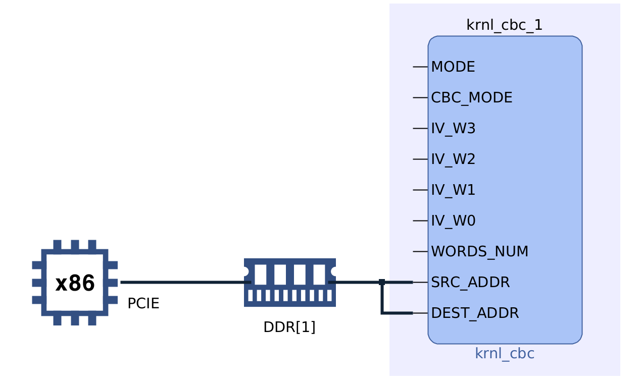
Kernel replacement
Change Kerenl_cbc_engine to implement simple addition (add 1 to input when mode = 1)

Slide 23
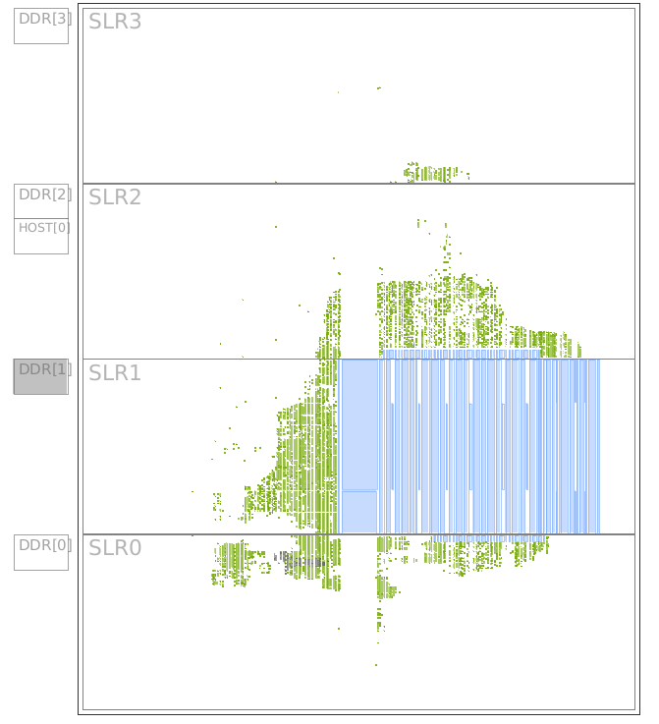
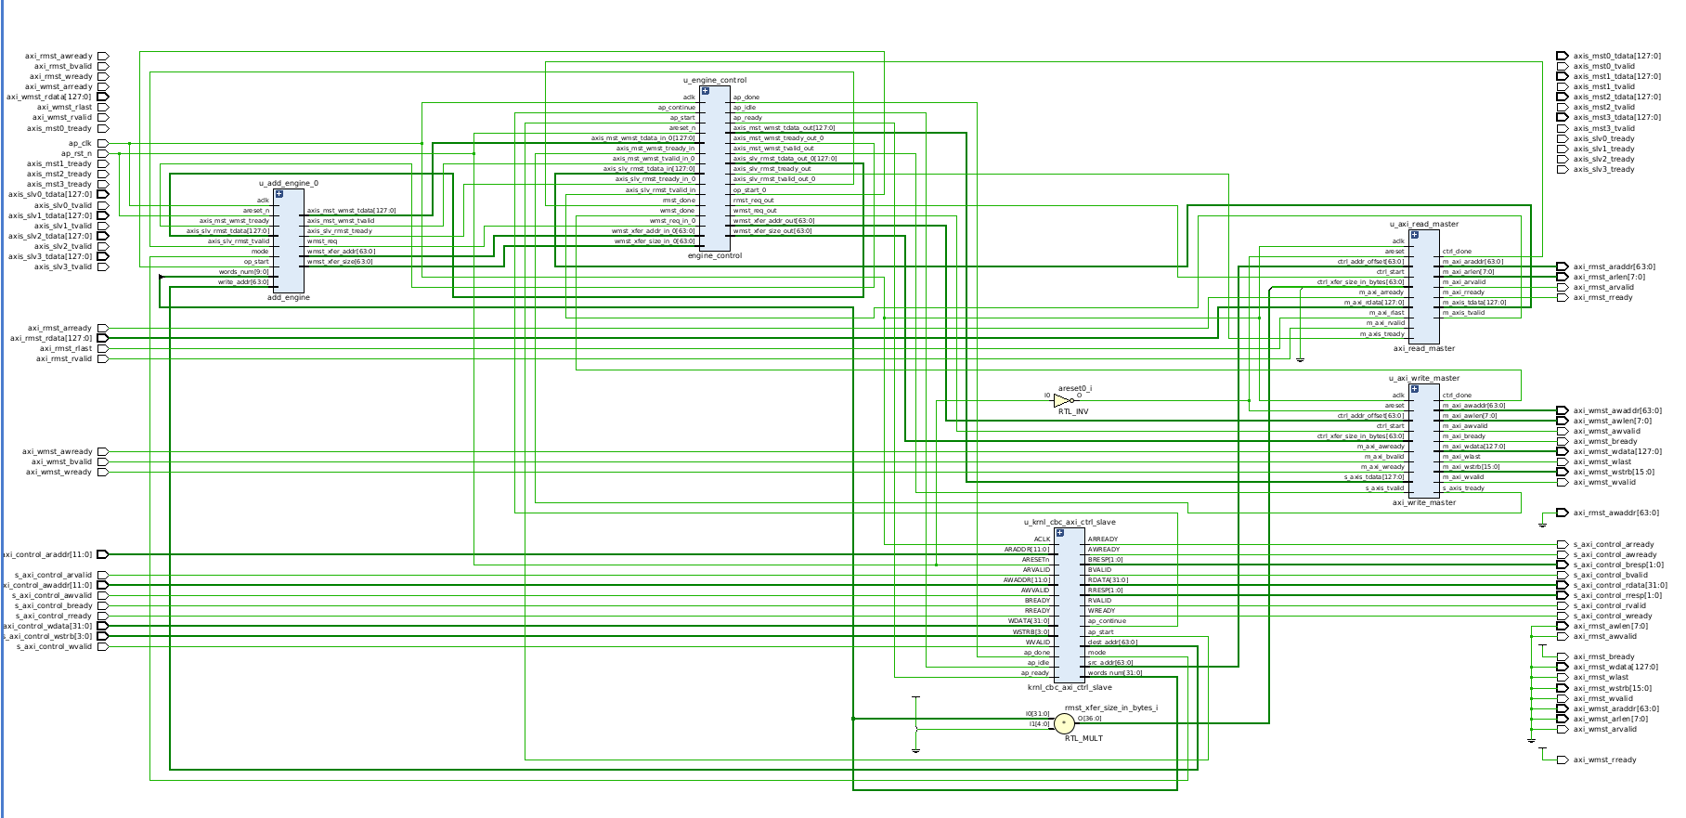
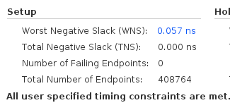
Kernel replacement
P&R, schematic

Slide 24


Kernel replacement
host_sw code modification, verification

Slide 25


Kernel replacement
host_sw code modification, verification

